Slide 1
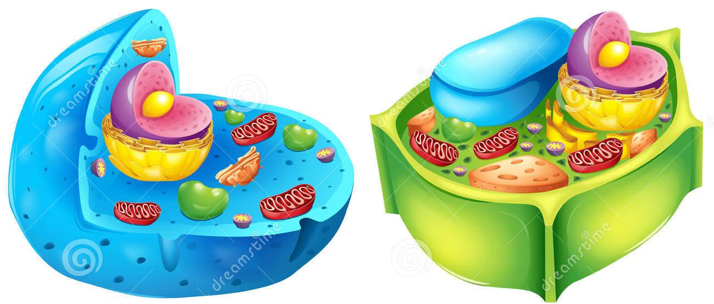
Cell Analogies
Using abstraction to show off your creativity and your knowledge of cells

Slide 2
Project goal: Use abstraction to represent a cell through the use of an analogy.

Slide 3
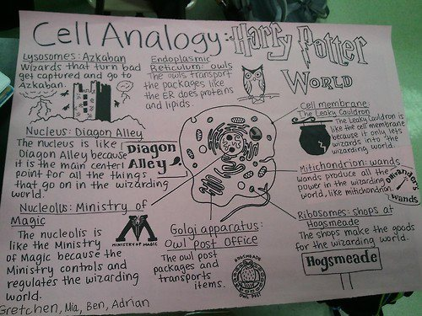

Slide 4
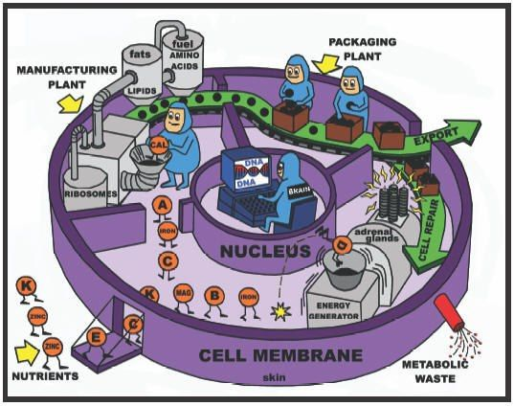
Possible analogies
A real or fictional place - city, amusement park, store, restaurant, sports arena, school…
An existing or made up game
An existing or made up story
An app - SnapChat, Instagram, YouTube...

Slide 5
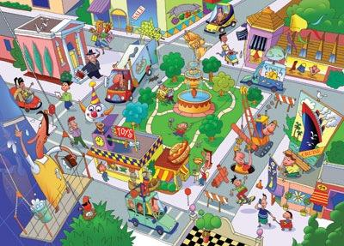
Step 1: Brainstorm what analogy you want to use, and how each cell part fits into your analogy
A. Cell = City
B. Cell membrane = City limits
C. Cytoplasm = Environment
D. Nucleus = Town Hall
F. Ribosomes = Factory
G. Endoplasmic Reticulum = Roads and Highways

Slide 6
Step 2: Visually create your analogy
Can be a map/drawing, a board game, an illustrated story, a labeled app walkthrough, etc.
Can be done on an 11x17” piece of paper, in a Google Presentation, or in Scratch.
Make it colorful and creative, and don’t forget to include something to represent each cell part!
You may label cell parts directly, or label them with letters and include a legend or map key.

Slide 7
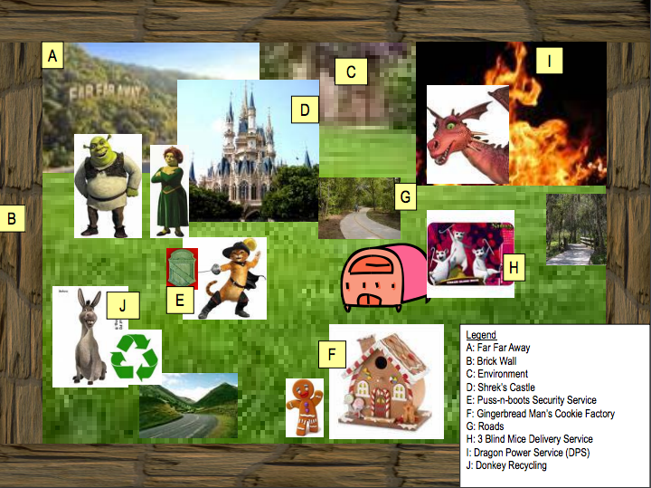

Slide 8
Step 3: Explain your analogy
Justify why you selected each component of your analogy to represent that part of the cell and what that analogy part and the cell part have in common
Identify the type of cell you picked by writing down whether it is a plant or animal cell
For each component, include:
the name of the component
the name of the cell part it corresponds to
why you selected that component to represent the cell part. For example, the Town Hall represents the nucleus because it controls the town’s activities.

Slide 9
